Slide 2
PRIZE CEREMONY IAS/Abivax Research-for-Cure Academy Fellowship Prize
Presented by
Sharon Lewin, IAS Towards an HIV Cure Advisory Board
Ian McGowan, Abivax Scientific Advisory Board

Slide 3
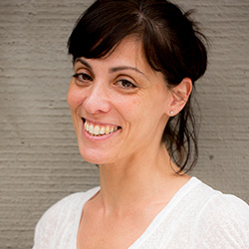
The 2019 IAS/Abivax Research-for-Cure Academy Fellowship Prize is awarded to
Natalia Laufer
Argentina
for her engagement during the 2018 Research-for-Cure Academy, collaborative spirit demonstrated in the research project work and continued engagement in the HIV cure field.

